Slide 1
Receipt & Invoice Digitizer
Tech: Streamlit | OpenCV | Tesseract | Gemini | SQLite | Plotly
Prepared by: DivyaSri Yaganti

Slide 2
Problem Statement
Receipts and invoices are mostly stored as paper/images
Manual record keeping leads to:
loss of bills
difficulty in tracking expenses
time-consuming data entry
Businesses and individuals need a tool to automate digitization and expense analytics

Slide 3
Project Objective
The system aims to:
Convert invoices/receipts into structured digital records
Extract key information like:
vendor name, date, items, tax, total
Ensure correctness using validation
Store records for future use
Provide insights via dashboard analytics

Slide 4
MileStone-2
Objective of Milestone 2
Convert raw OCR text into structured data
Extract key invoice fields
Validate financial correctness
Detect duplicate invoices
Store validated data in database

Slide 5
AI-Based Field Extraction
Gemini AI Integration
Uses Gemini LLM for structured extraction
Converts raw OCR text → JSON
Enforces strict schema
Reduces manual parsing errors
📌 AI improves accuracy on complex receipts

Slide 6
Fallback Extraction (Fail-Safe)
Why Fallback is Needed
If Gemini fails:
API limit
Network issue
➡️ System switches to:
Regex-based extraction
Rule-based parsing
📌 Ensures system never fails completely

Slide 7
Validation Logic
Invoice Validation Rules
Sum of items = Total → VALID
Sum of items + Tax = Total → VALID
Otherwise → NOT VALID
Additional checks:
Missing fields
Invalid totals
📌 Prevents incorrect data storage

Slide 8
Duplicate Invoice Detection
Raw OCR text compared against database
First 200 characters used for similarity check
If duplicate found:
Invoice is not re-inserted
Existing record is reused
Benefit:
Prevents duplicate spending records
Ensures clean financial history

Slide 9
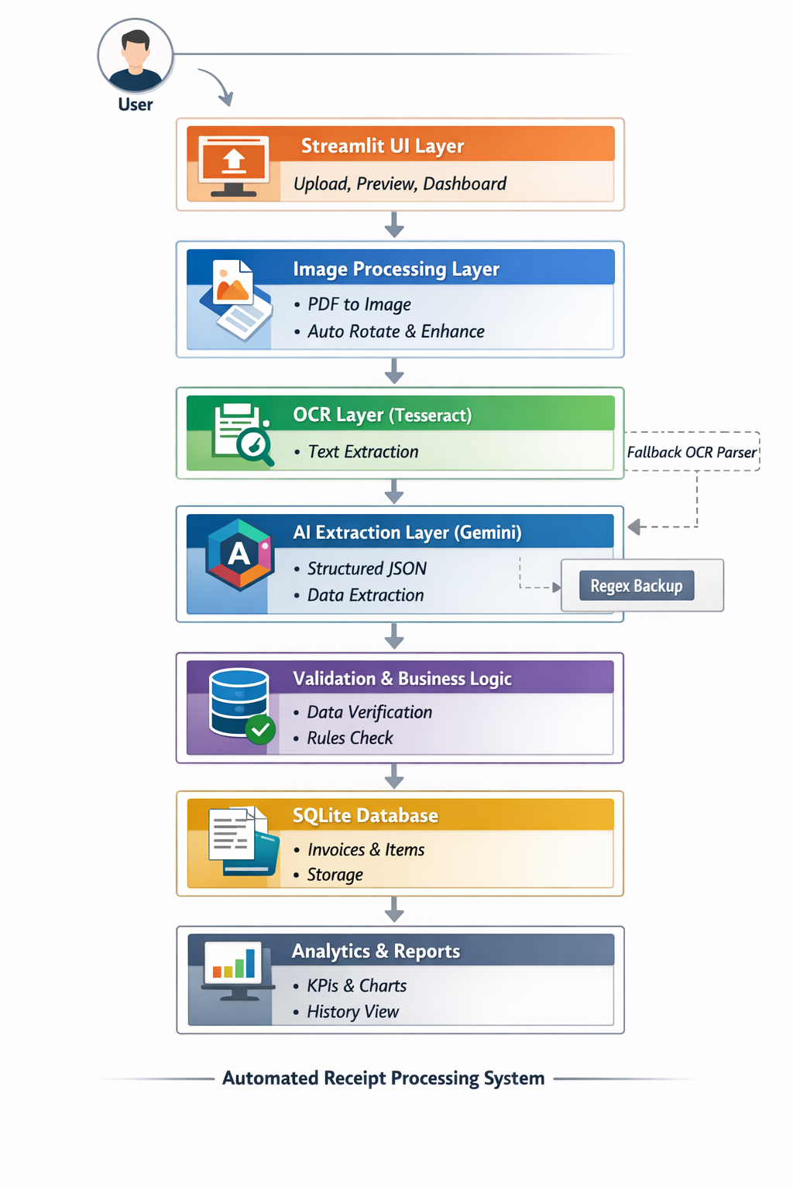
Architecture

Slide 10
Structured Data Storage (SQLite)
Database Tables:
invoices
Vendor, date, total, tax, category, currency, validation status
items
Line-level item details
Features:
Foreign key linking
Automatic category classification
Timestamped records

